Slide 1
Chapter 8 Confidence Intervals
Section 1: The Basics

Slide 2
Statistical Inference
Provides methods for drawing conclusions about populations from sample data
When using inference, we always act as though the data were produced from a random sample or experiment

Slide 3
Two Types
Two Types:
Confidence intervals (Chp 8)
Significance Testing (Chp 9)

Slide 4
Backtrack….to move forward
Suppose an admissions team at a university wants to use IQ scores to determine admission. They give an IQ test to a SRS of 50 current students of the school’s 5000 freshmen. The mean IQ for this sample is 112.
What can the director say about the mean score µ of the population of all 5000 freshmen?

Slide 5
IQ Example ctd..
Could we blindly estimate µ to be 112?
How close would we be?
What would a better question be?
How would the sample mean vary if we took many samples of 50 freshmen from this same population?

Slide 6
IQ Example ctd..
How would the sample mean vary if we took many samples of 50 freshmen from this same population?
To figure this out we need to use…….
SAMPLING DISTRIBUTIONS

Slide 7
IQ Example ctd..
What do we know……
The mean of the sampling distribution is the same as the unknown mean of the entire population.
The standard deviation for a SRS of 50 freshmen is
So suppose the standard deviation is 15, then the standard deviation of the sampling distribution is:

Slide 8
IQ Example ctd..
The CLT tells us that the sampling mean of 50 scores has a distribution approximately normal.
Thus we will use the sampling mean to estimate the population, however, even though it is an unbiased estimate, it will rarely be exactly equal.

Slide 9
IQ Example ctd..
So, we have a Normal distribution with mean µ and standard deviation of 2.1
We have everything we need now, but what is it that we were trying to do?
Estimate the mean, µ, of the population!

Slide 10
IQ Example ctd..
To do this, we want to come up with an interval that the mean will be in (remember, we are estimating here!)
The empirical rule tells us 95% of our data lies within 2 standard deviations of the mean.
Thus we can estimate (with 95% confidence) µ to be within

Slide 11
Definitions
Confidence interval:
A set of population values from which our found sample value is likely.
We use them to estimate the unknown population mean.
General Form:
In the prior example, the confidence interval is

Slide 12
Definitions
Confidence level:
The success rate of the method used to construct the interval (ie, the probability the interval will capture the true parameter value in repeated samples)
In the prior example the confidence level was:
95%

Slide 13
C.I. for Population Means (when σ is known)
To find the CI for a population mean µ, we need to meet 3 conditions:
SRS – data must come from SRS from the population of interest
Normality – the sampling distribution is apprx normal
Independence – the population size is at least 10 times the sample size

Slide 14
Margin of Error
With any estimation there will be error in our results. We need to incorporate this in our confidence interval
To calculate our margin of error, we will use:
m = (critical value)· (std dev of statistic)

Slide 15
Margin of Error
Remember- Shows how accurate we believe our estimate is.
The smaller the margin of error, the more precise our estimate is of the true parameter.
To be more precise, we will use critical values to calculate our margin of error.

Slide 16
Critical value, z*
Found from the confidence level
The upper z-score with probability p lying to its right under the standard normal curve.
Confidence Level | Tail Area | z*
90% | .05 | 1.645
95% | .025 | 1.96
99% | .005 | 2.576

Slide 17
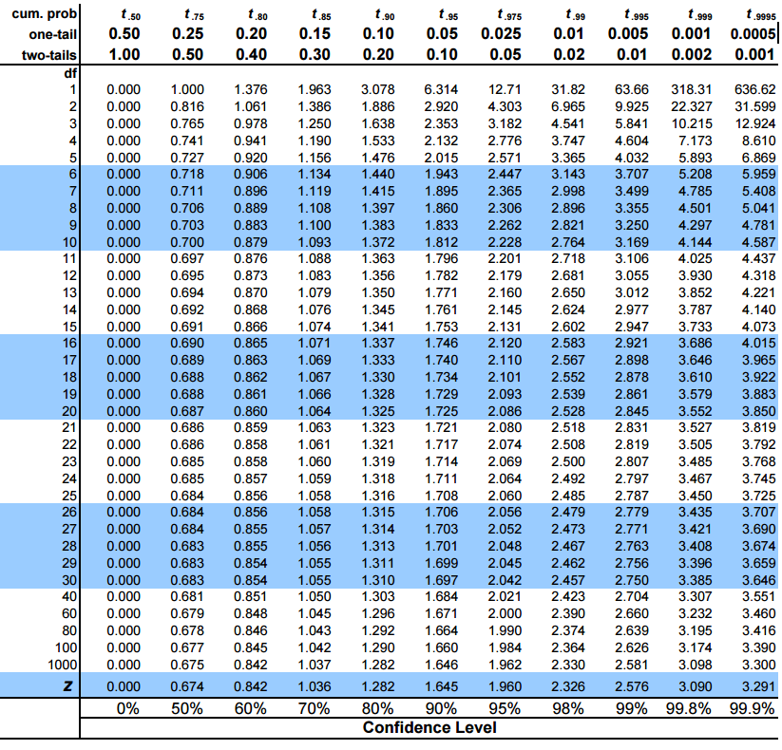

Slide 18
C.I. for Population Means (when σ is known)
Choose a SRS of size n from a population having unknown mean µ and known standard deviation σ. A level C confidence interval for µ is:

Slide 19
Steps for finding CI
Check Assumptions –
SRS?
Distribution Normal?
σ is known?
Calculate the interval
Write a statement about the interval in the context of the problem.
We are % confident that the true mean context lies within the interval and ___.

Slide 20
PRACTICE IT!
A test for the level of potassium in the blood is not perfectly precise. Suppose that repeated measurements for the same person on different days vary normally with σ = 0.2. A random sample of three has a mean of 3.2. What is a 90% confidence interval for the mean potassium level?

Slide 21
Practice 1: 90% CI
If we calculate with 90% confidence:

Slide 22
Practice 1: 95% CI
If we calculate with 95% confidence:

Slide 23
Practice 1: 99% CI
If we calculate with 99% confidence:

Slide 24
As confidence increases…
What happens to the interval as confidence increases?
The interval gets wider!!!

Slide 25
Can we make M.o.E smaller?
z* smaller → lower confidence level
σ smaller → less variation in population
n larger → to cut margin of error in half, n must be 4 times as large

Slide 26
Practice 2:
A random sample of 50 students was taken and their mean SAT score was 1250. (Assume σ = 105) What is a 95% confidence interval for the mean SAT scores of students?

Slide 27
Determining Sample Size
If we wanted to determine an appropriate sample size for a desired margin of error we would use:
Note: The size of the sample influences the margin of error. The size of the population does not influence the sample size we need.

