Slide 1
Chapter 8: Confidence Intervals
Section 2: Estimating a Population Proportion

Slide 2
Margin of Error
To calculate our margin of error in this case, we will use:

Slide 3
CI for Population Proportion (when p is known)
Choose a SRS of size n from a population having unknown proportion p of successes. An approximate level C confidence interval for p is:

Slide 4
PRACTICE IT!
A May 2000 Gallup Poll found that 38% of a random sample of 1012 adults said that they believe in ghosts. Find a 95% confidence interval for the true proportion of adults who believe in ghost.
We are 95% confident that the true proportion of adults who believe in ghosts is between 35% and 41%.

Slide 5
Determining Sample Size
If we wanted to determine an appropriate sample size for a desired margin of error we would use:

Slide 6
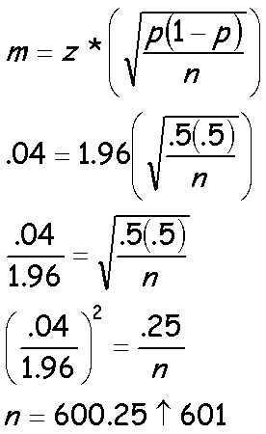
PRACTICE IT!
Another Gallop Poll is taken in order to measure the proportion of adults who approve of attempts to clone humans. What sample size is necessary to be within + 0.04 of the true proportion of adults who approve of attempts to clone humans with a 95% Confidence Interval?

