Slide 1
Density Curves
Examples and question take from book.

Slide 2
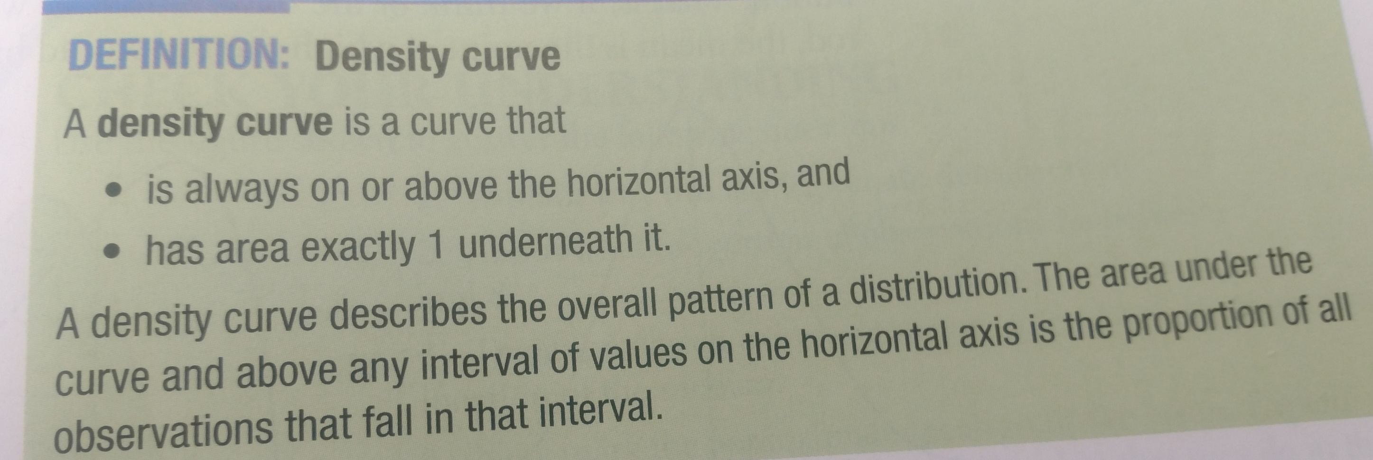
Page 105

Slide 3
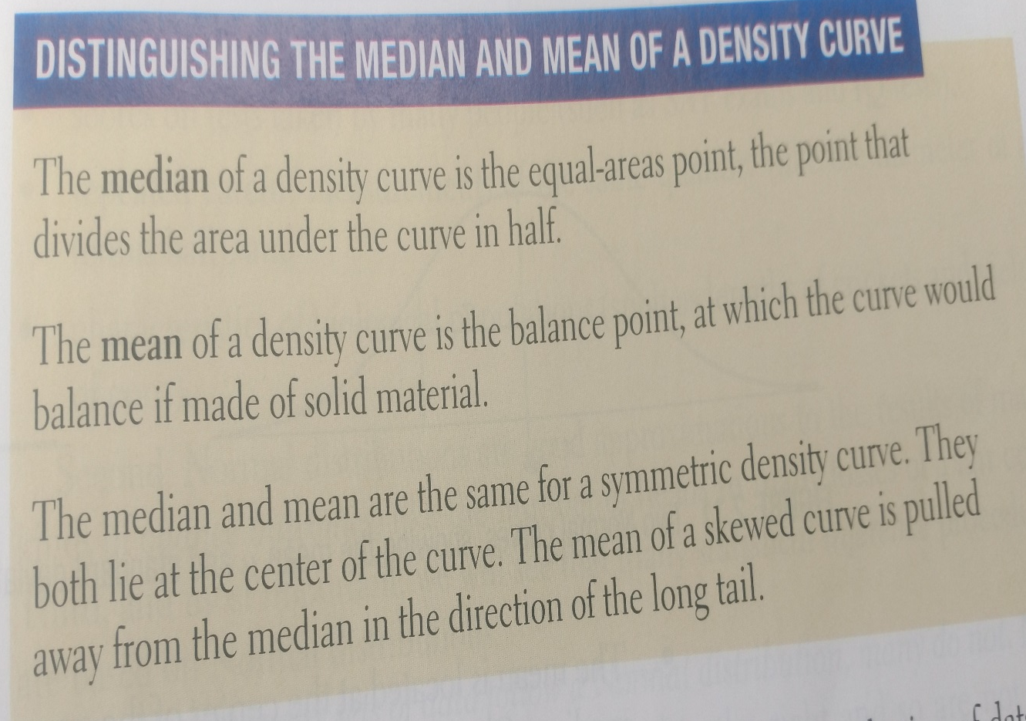
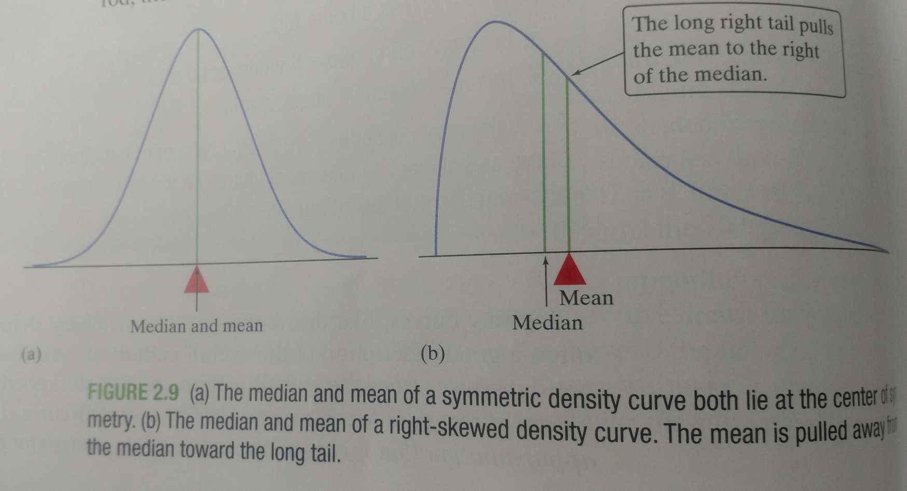
Page 106 and 107

Slide 4
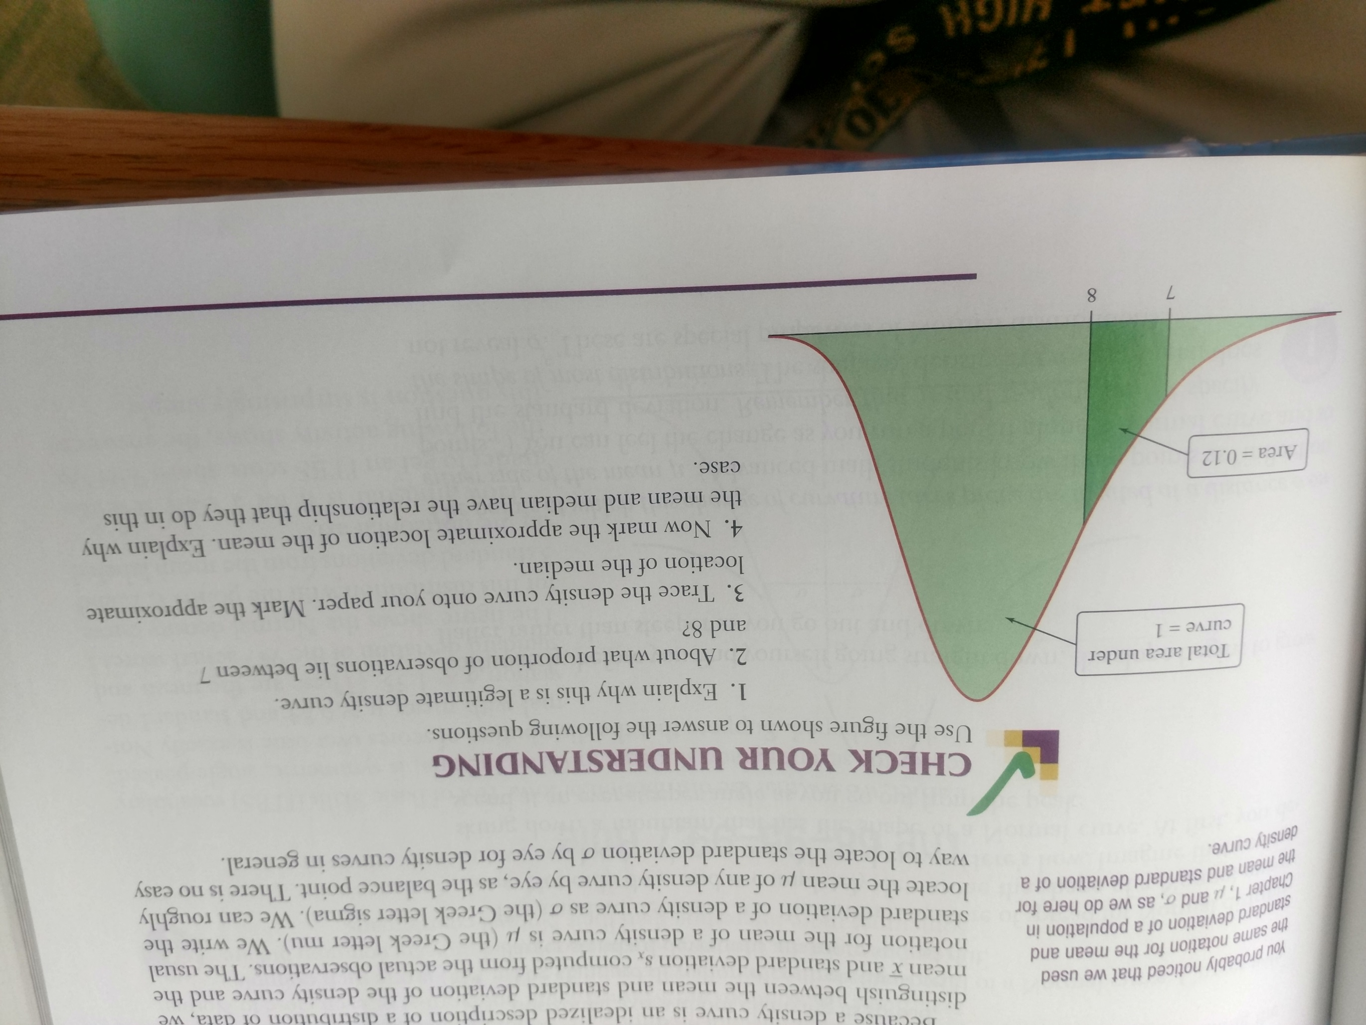
Page 107

Slide 5
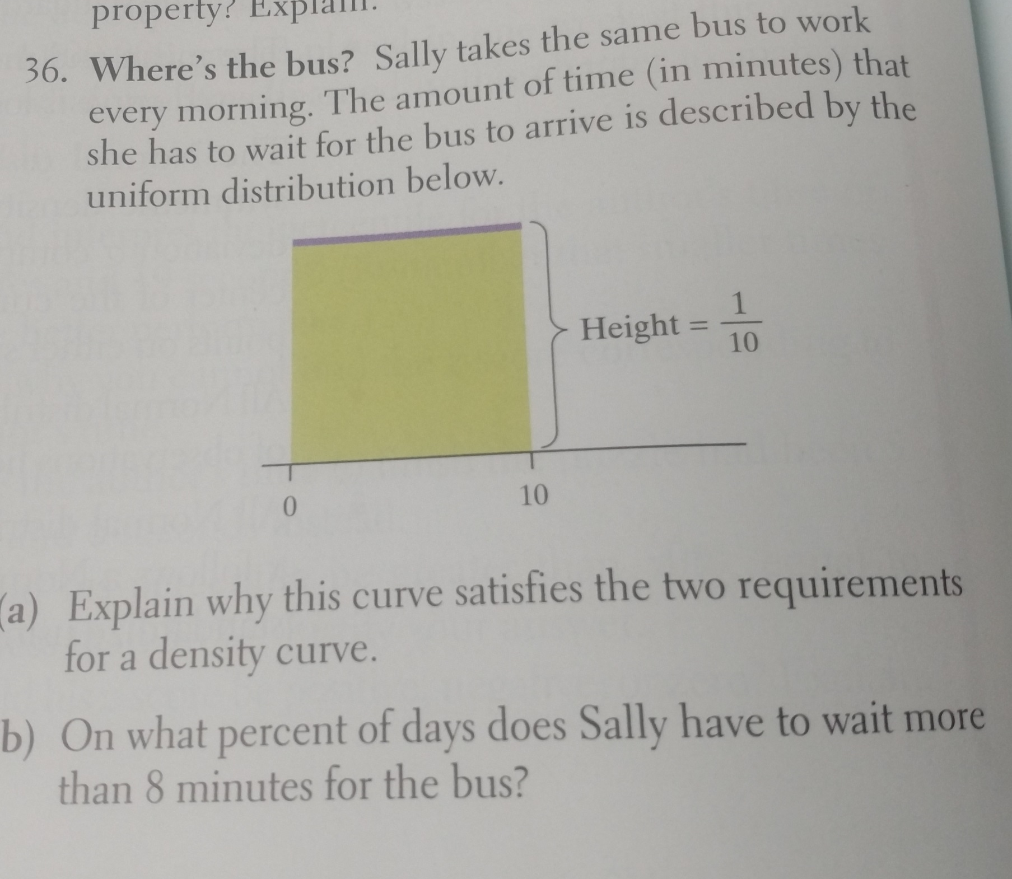
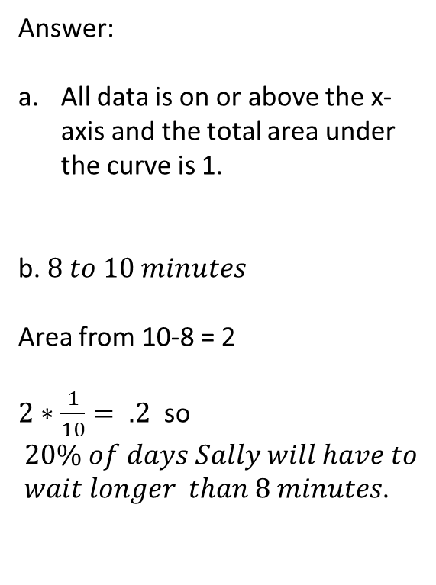
Page 128
Answer:
All data is on or above the x-axis and the total area under the curve is 1.
b. $8 to 10 minutes$
Area from 10-8 = 2
$2∗\frac{1}{10}= .2$ so $20\% of days Sally will have to$
$wait longer than 8 minutes$.

Slide 6

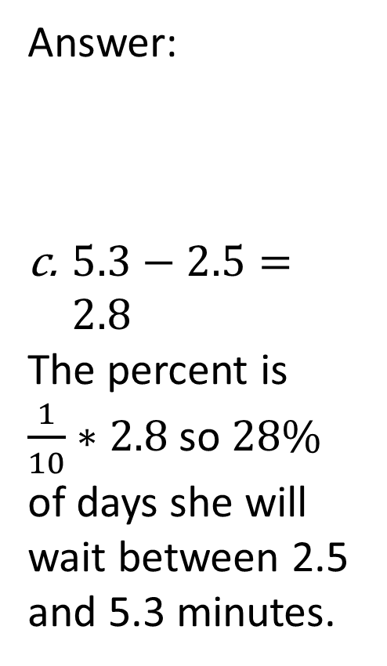
Answer:
$5.3−2.5=2.8$
The percent is $\frac{1}{10}∗2.8$ so $28\%$ of days she will wait between 2.5 and 5.3 minutes.
c. On what percent of days does Sally wait between 2.5 and 5.3 minutes for the bus?

