Slide 1
Normal Probability Plot
Examples and Images credited to
https://www.spcforexcel.com/knowledge/basic-statistics/normal-probability-plots
http://www.itl.nist.gov/div898/handbook/eda/section3/normprpl.htm#importance

Slide 2
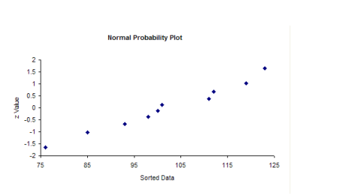
Construction
Plot Data Point in relation to Z-score

Slide 3
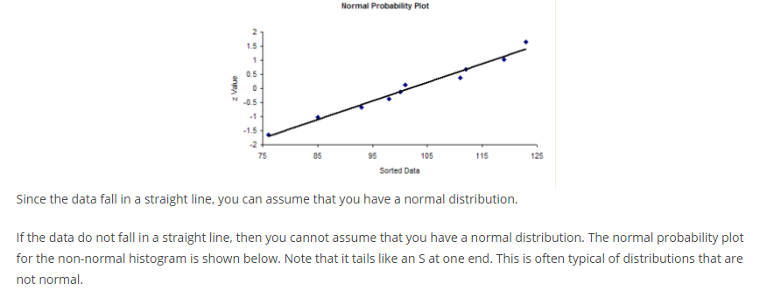
Do the points fall roughly in a straight line?

Slide 4
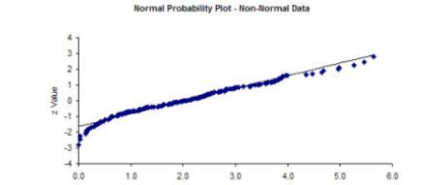
Non Normal Plot

Slide 5
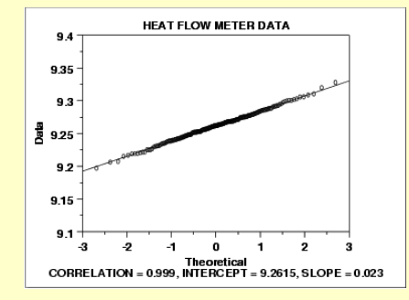
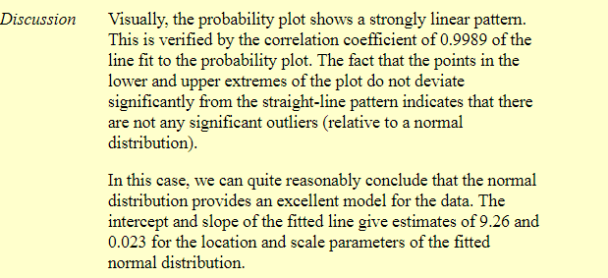
More Examples

Slide 6
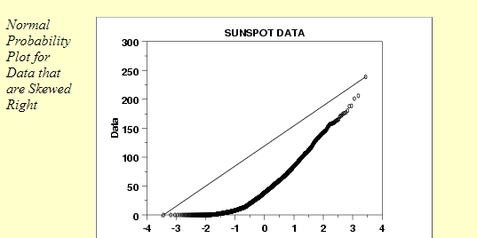
More Examples

Slide 7
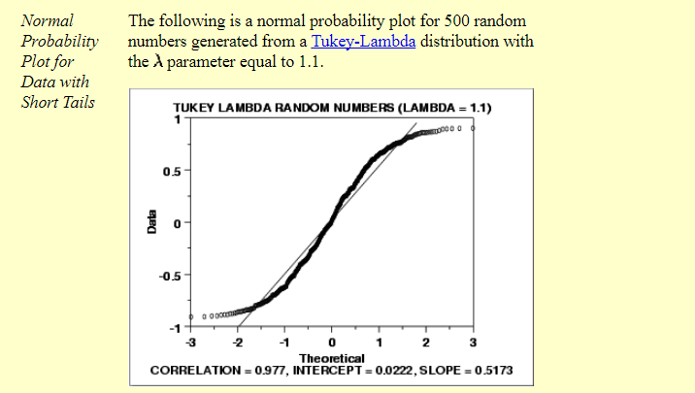
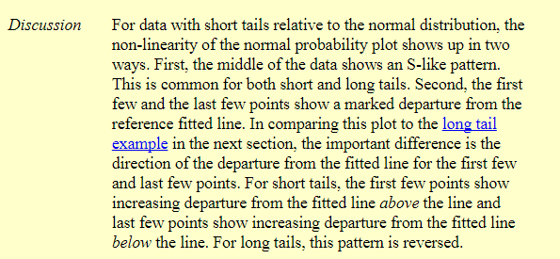
More Examples

Slide 8
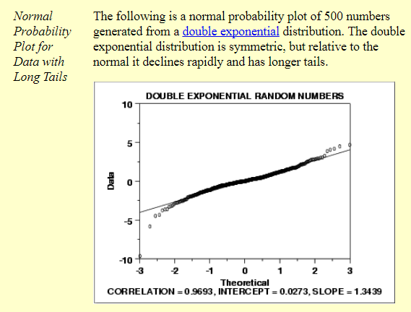
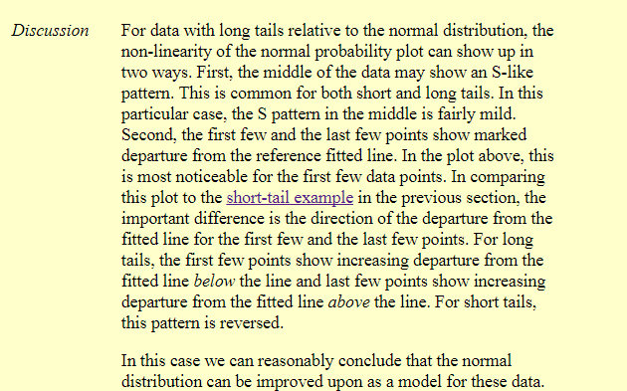
More Examples

Slide 9
C O N C L U S I O N

